Slide 1
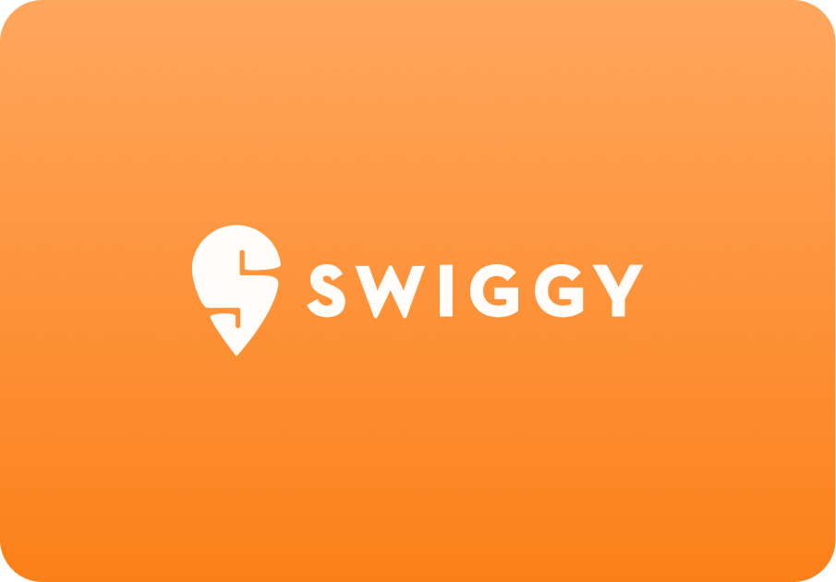
Case Study: Swiggy

Slide 2
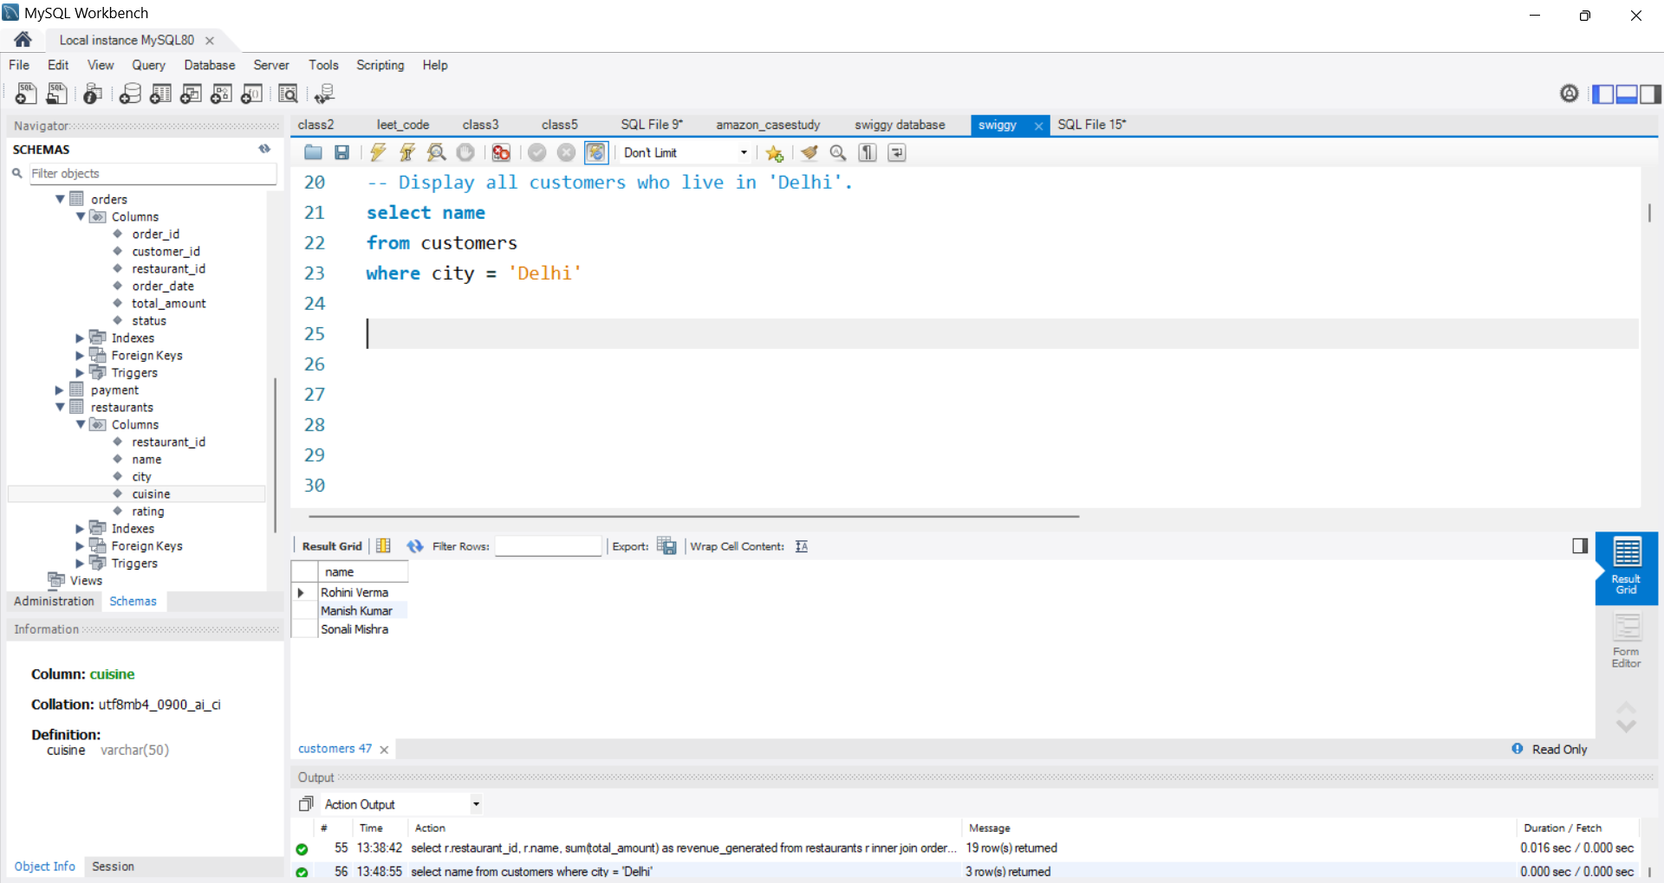
1. Display all customers who live in 'Delhi'

Slide 3
2. Find the average rating of all restaurants in 'Mumbai'

Slide 4
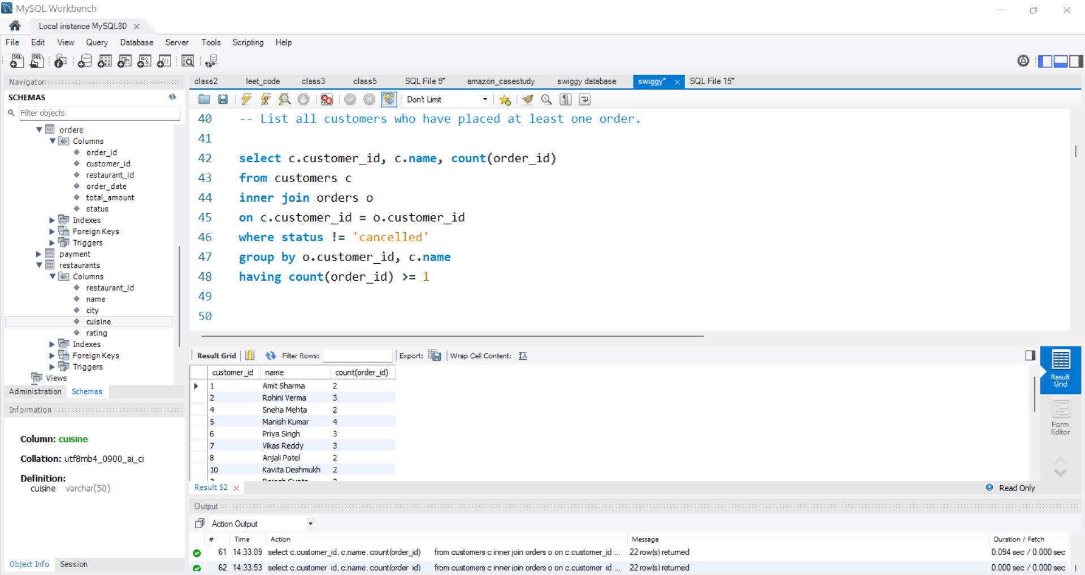
3. List all customers who have placed at least one order

Slide 5
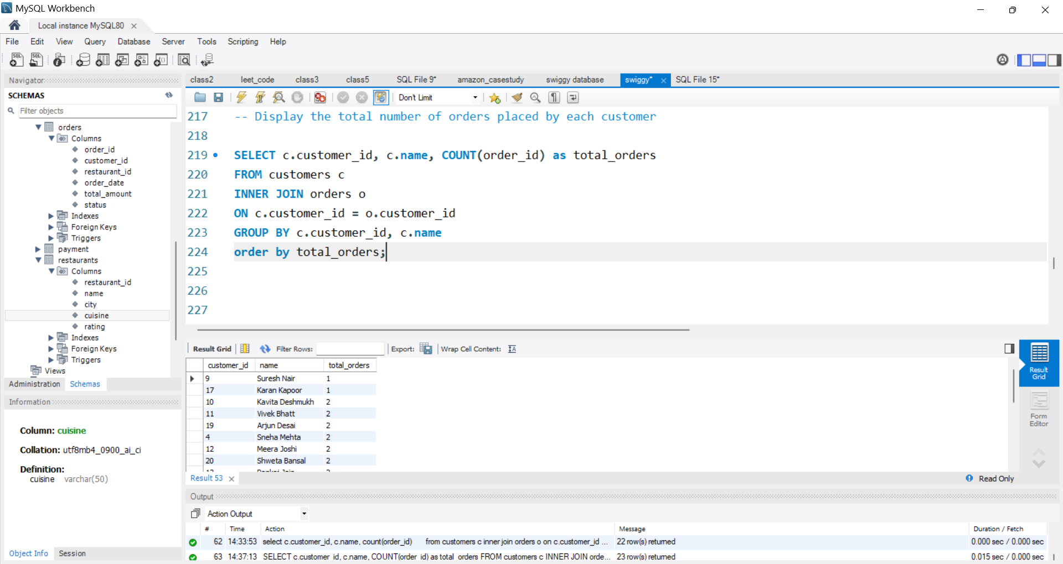
4. Display the total number of orders placed by each customer

Slide 6
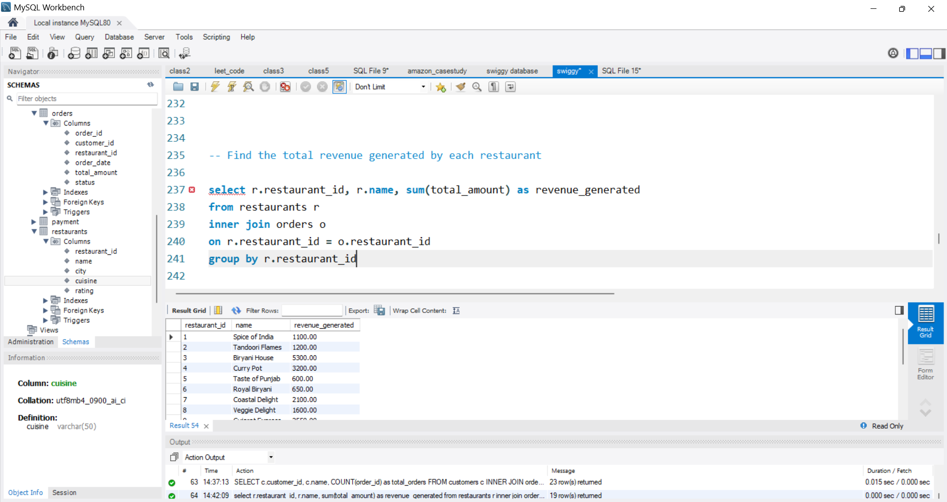
5. Find the total revenue generated by each restaurant

Slide 7
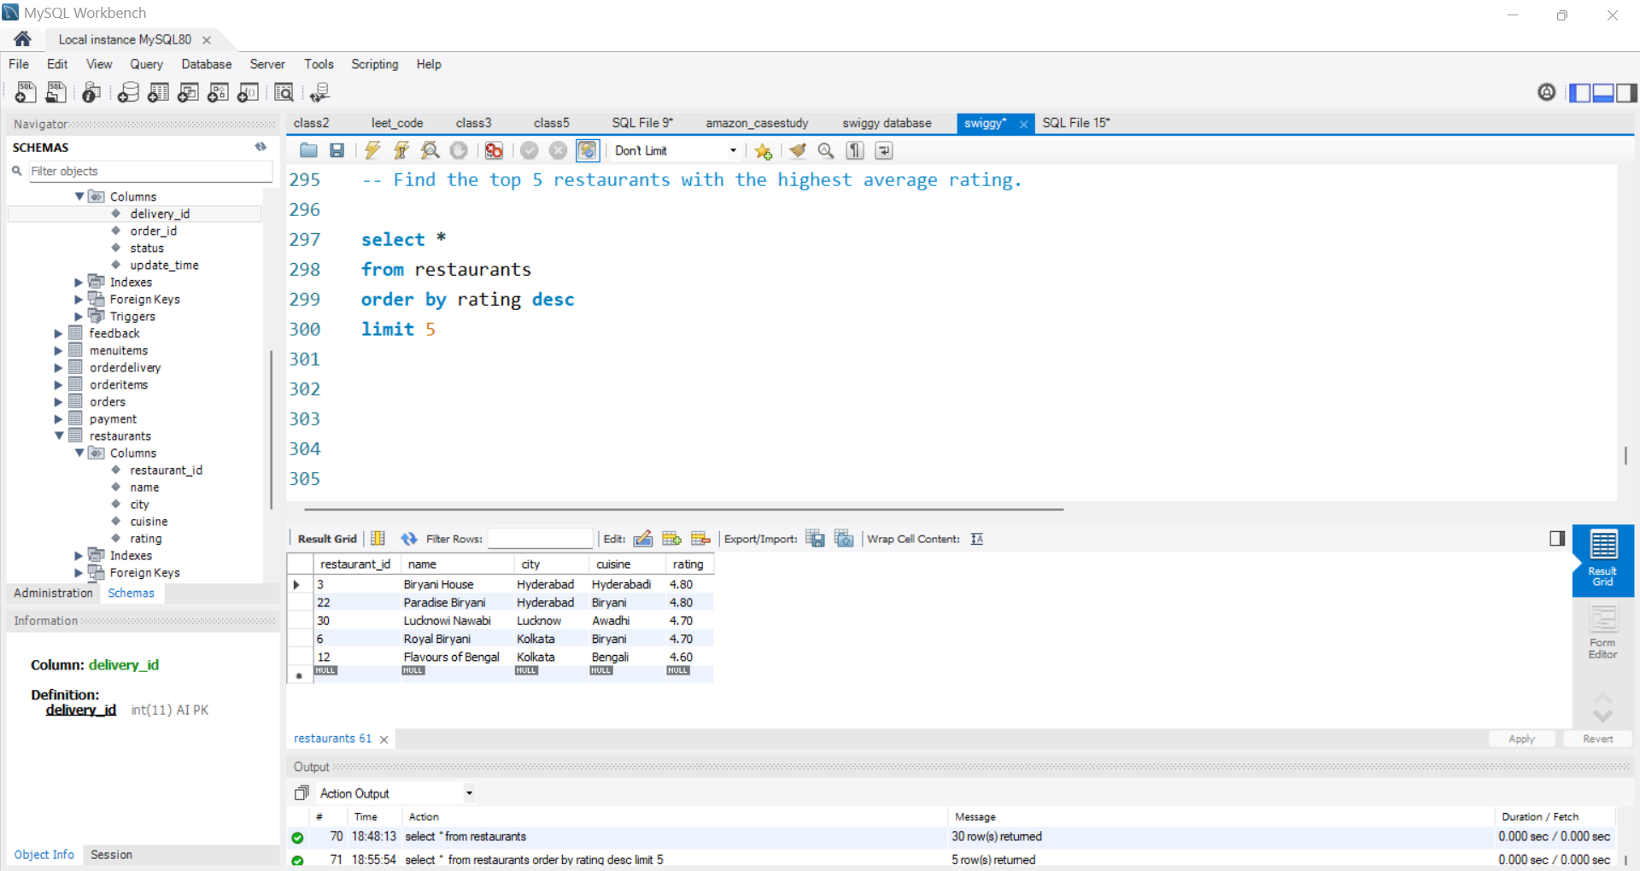
6. Find the top 5 restaurants with the highest average rating

Slide 8
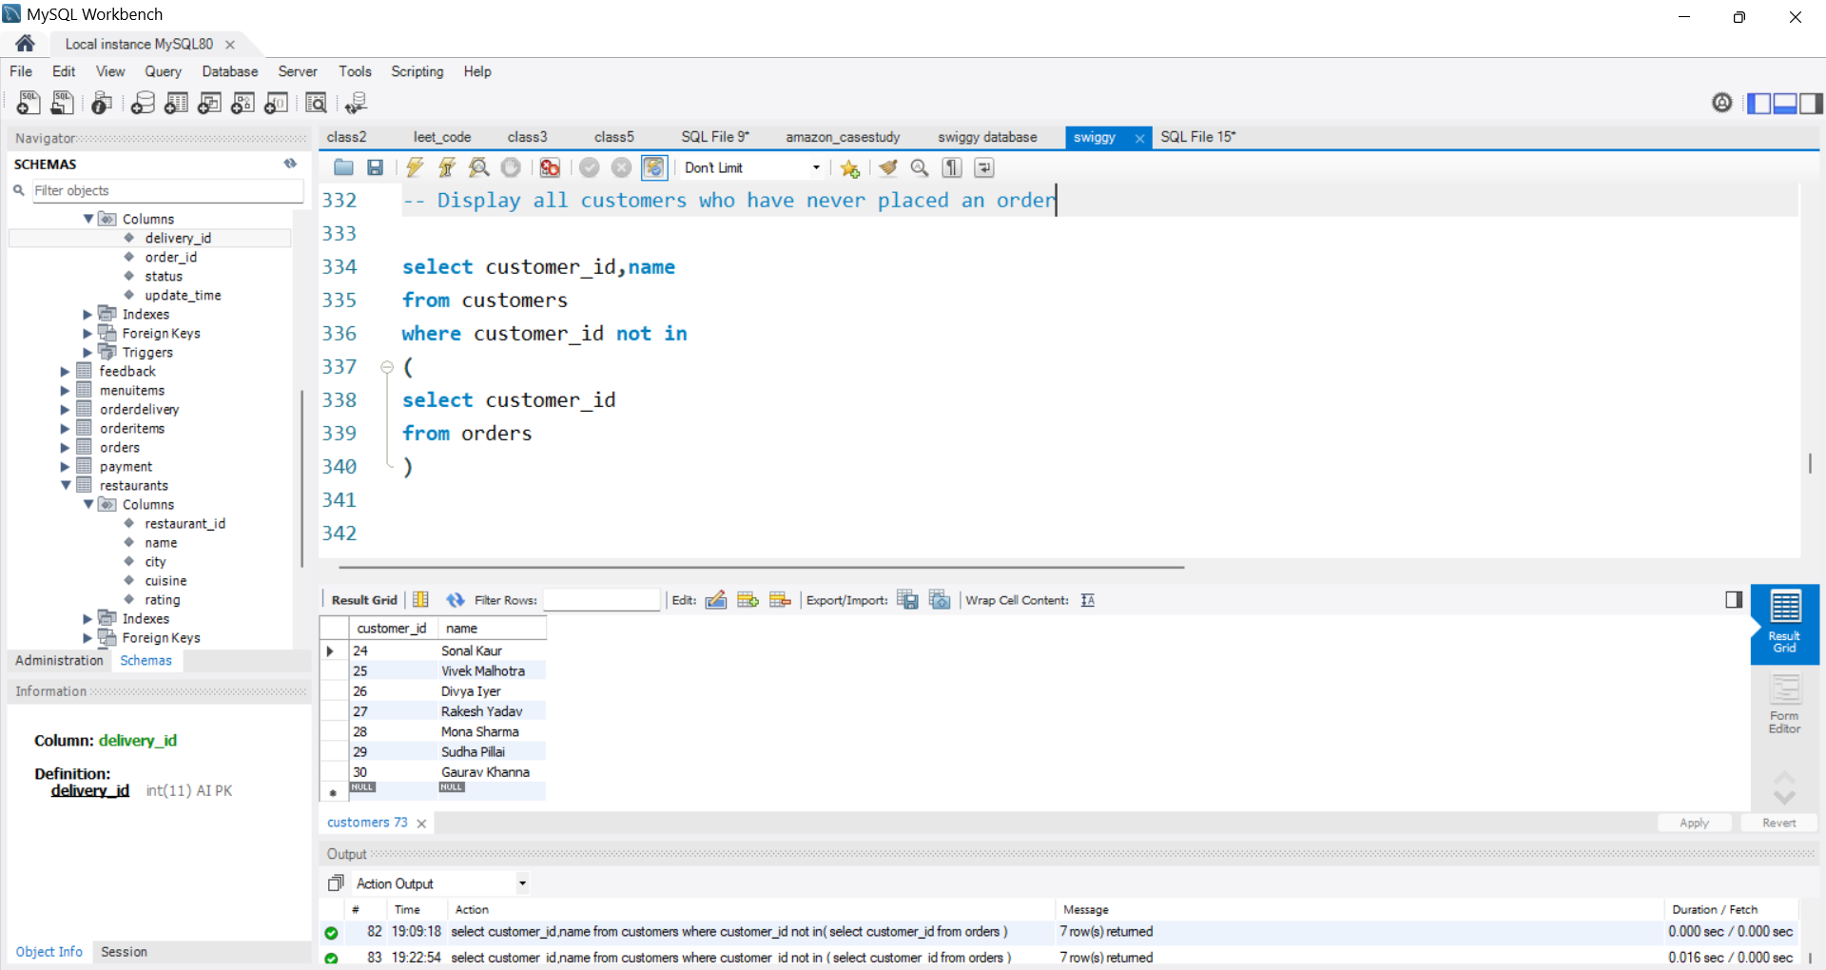
7. Display all customers who have never placed an order

Slide 9
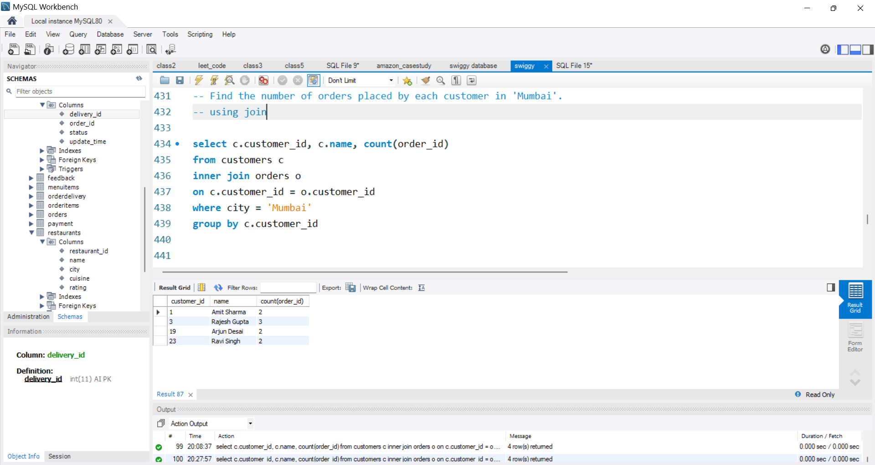
8. Find the number of orders placed by each customer in 'Mumbai'

Slide 10
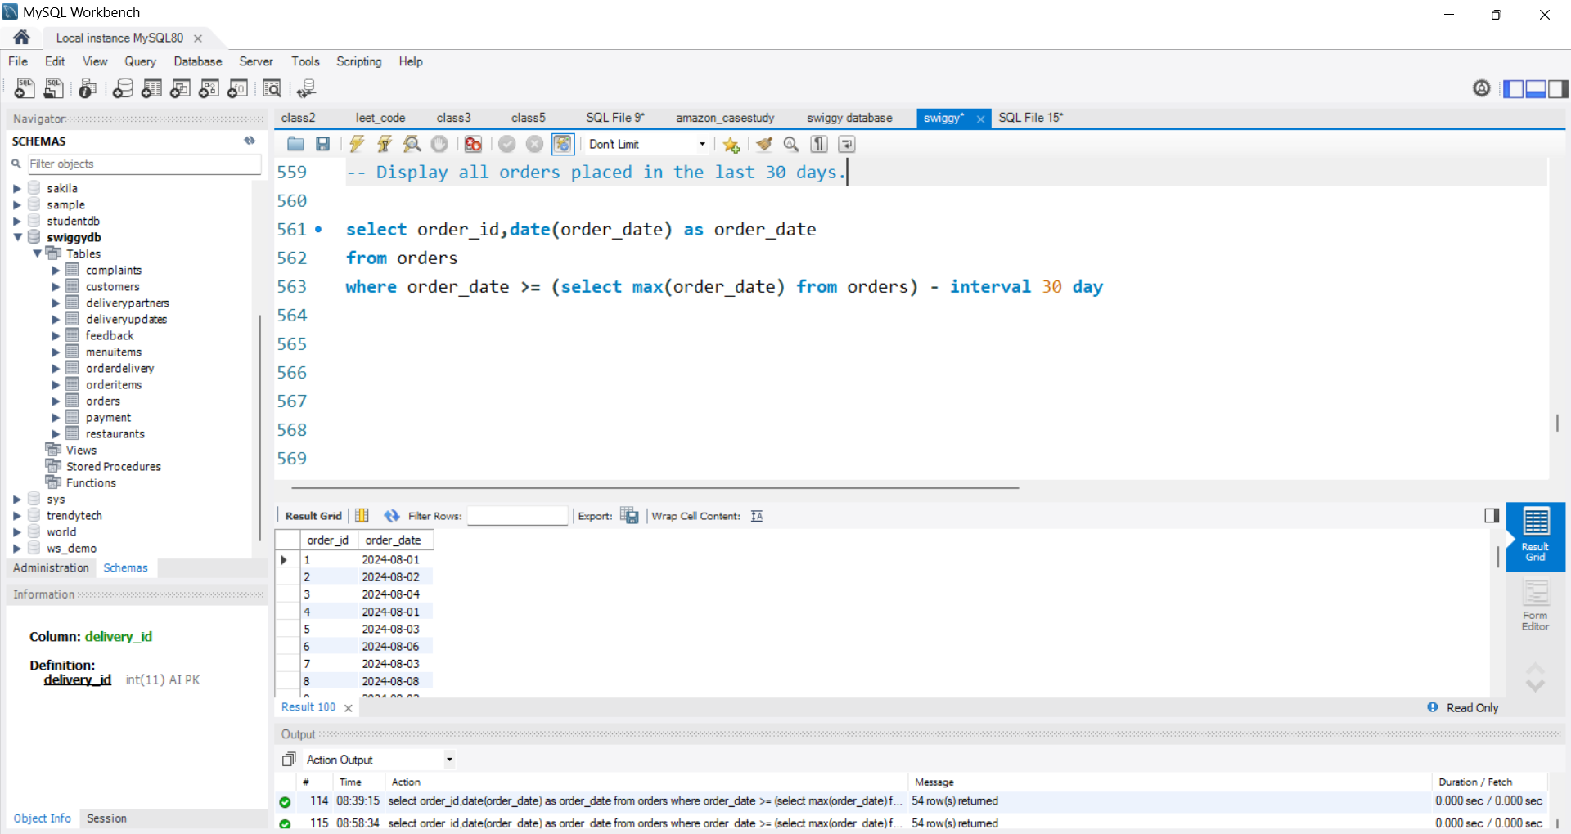
9. Display all orders placed in the last 30 days

Slide 11
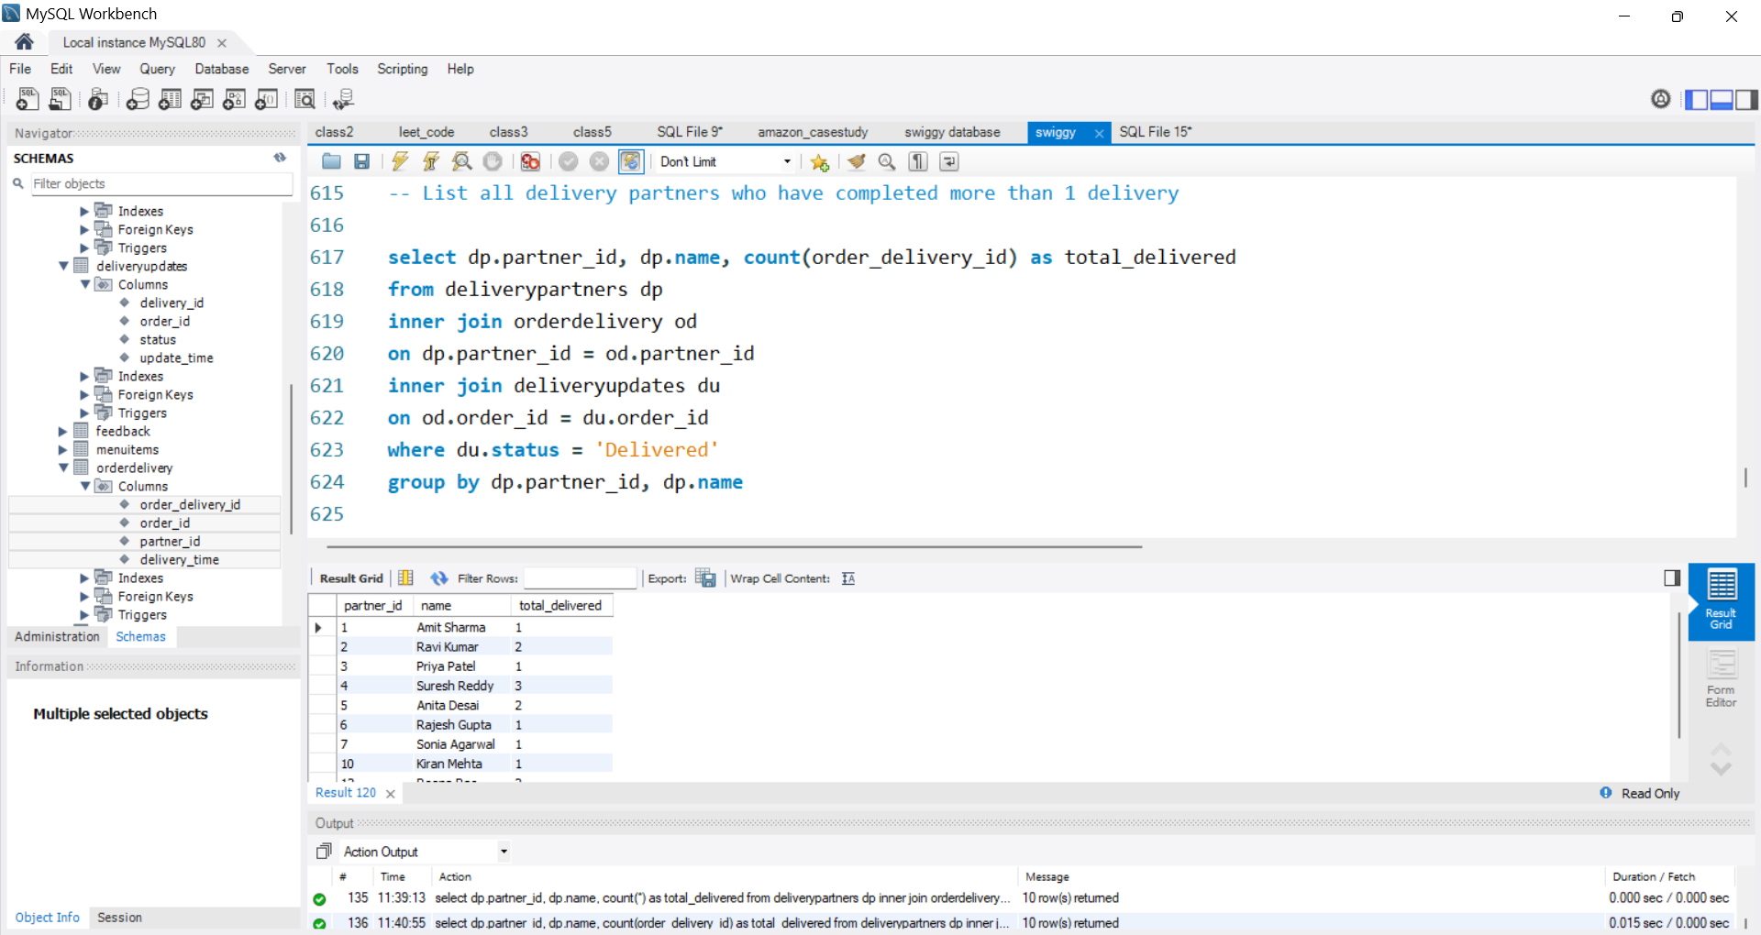
10. List all delivery partners who have completed more than 1 delivery

Slide 12
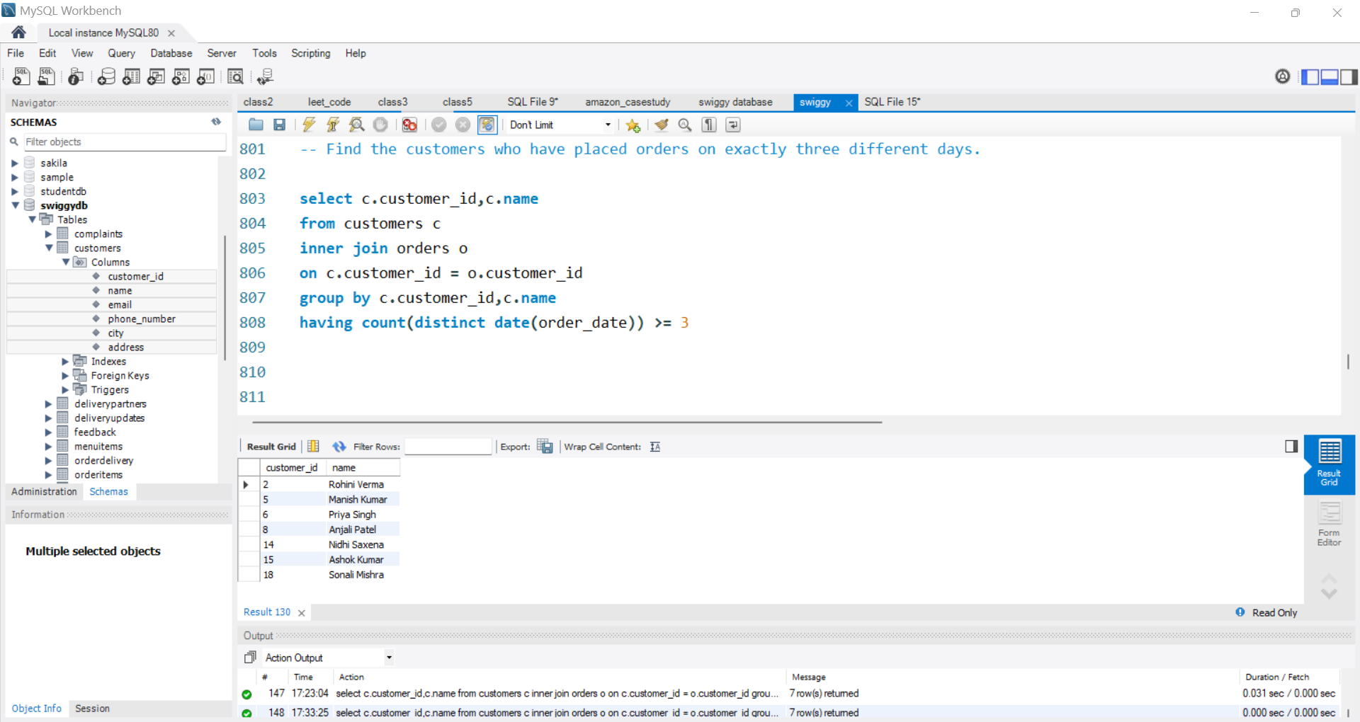
11. Find the customers who have placed orders on exactly three different days

Slide 13
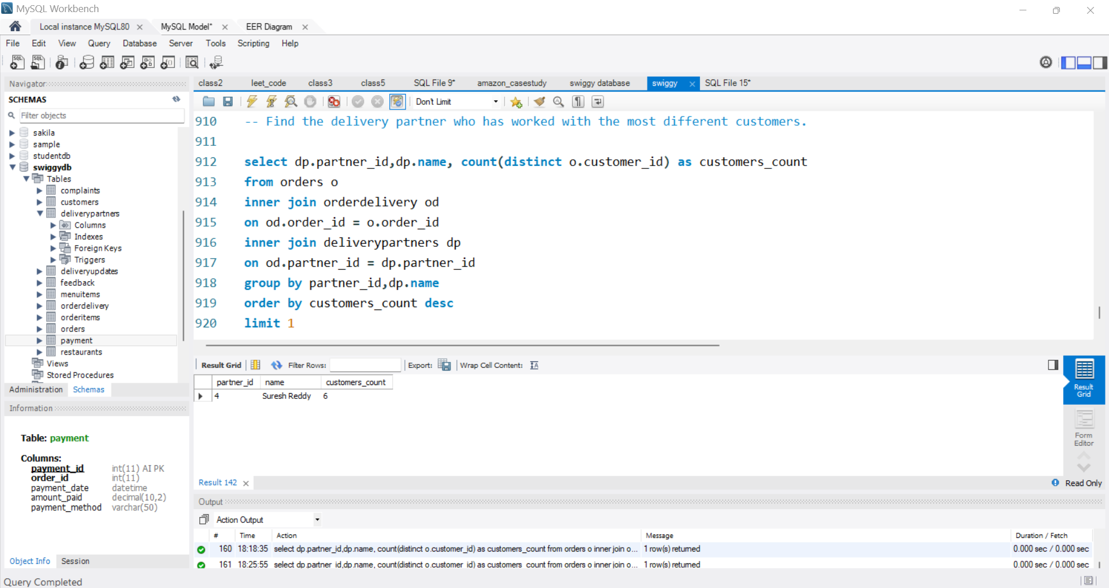
12. Find the delivery partner who has worked with the most different customers

Slide 14
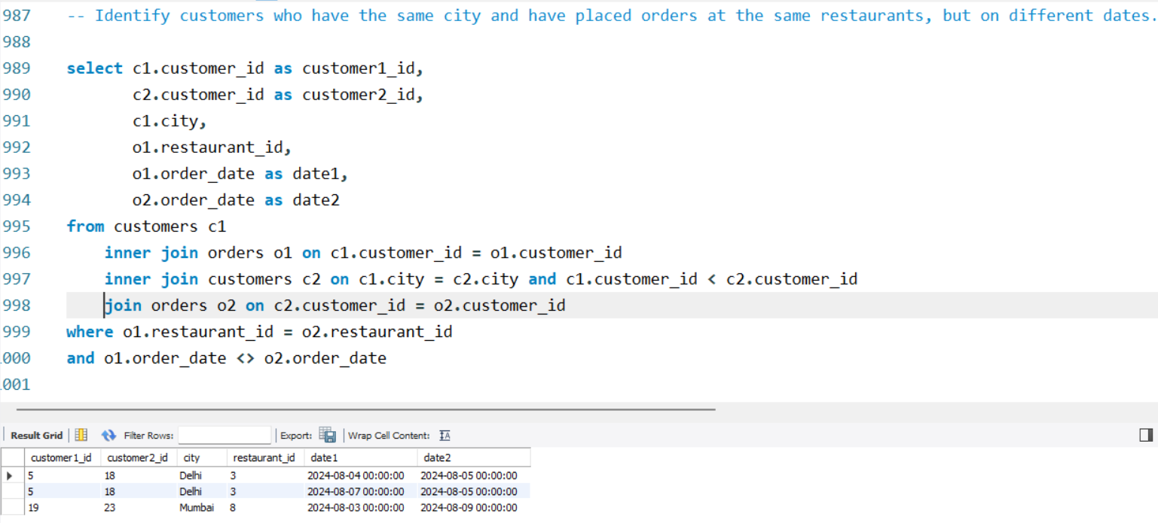
13. Identify customers who have the same city and have placed orders at the same restaurants, but on different dates

Slide 15
2. Find the average rating of all restaurants in 'Mumbai'
Thank You!!

